Slide 1
Montana uses of the Hydrography Dataset
InterMountain GIS 2014
NHD Workshop
April 7, 2014

Slide 2
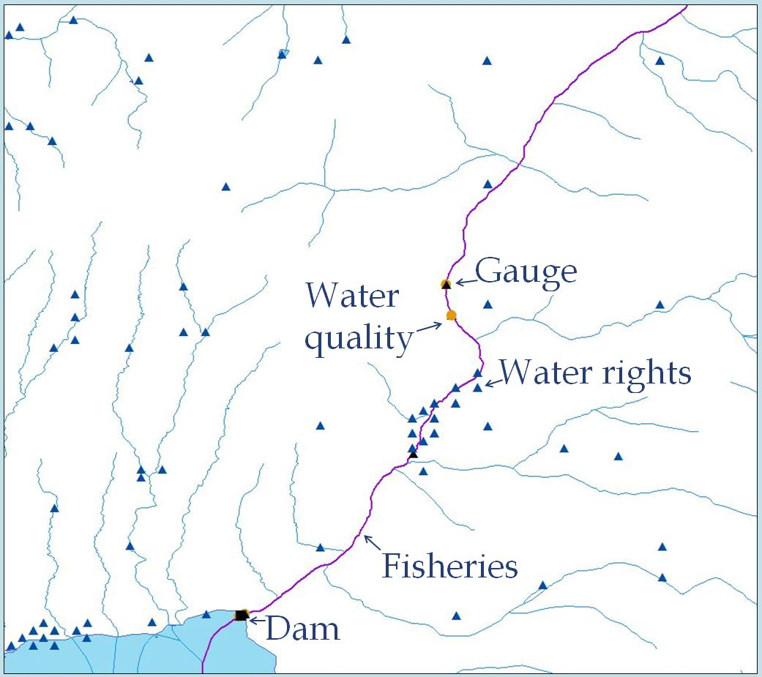
The Hydrography Dataset is a key component of the Montana Water Information System
A common spatial hydrography framework (GIS)
Notes:
To compliment the Water Information System website the State is moving towards restructuring the WIS such that its foundation is a common hydrography framework. The WIS will become more database driven, more spatial, more GIS-based!
There are several advantages:
1. Data become spatially-enabled and upstream, downstream, and other spatial relationships are more easily identified
2. Data are more easily tied together based on their location on the hydrography network.
Once data are tied to/hung-off a common framework, a common stream network, then data discovery, analysis, and modeling all become more straightforward.
Just about all data is spatial. The examples shown on the slide are all physical, measured objects (a dam, fish species, a gauge), but more abstract things such as a “study” or a “literature paper” could be tied to a stream network as well. For example, what if you could find all floodplain studies or papers written about the Madison below Ennis?

Slide 3
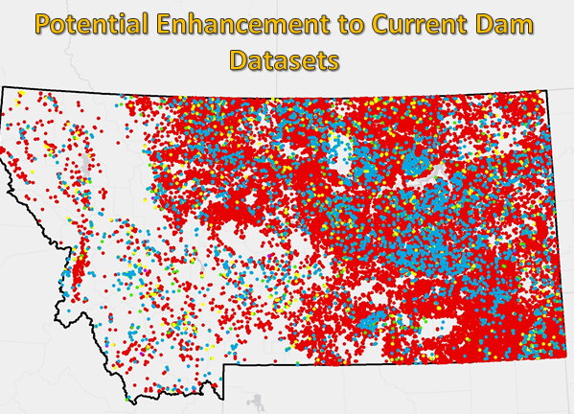
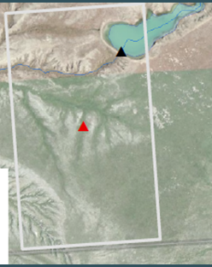
Hydrography Dataset Uses
Water Rights
Cumulative effects of small ponds in the CMR Refuge
Identification of dams located on State-owned lands

Slide 4
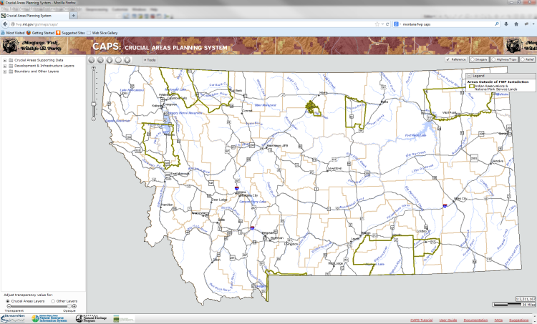
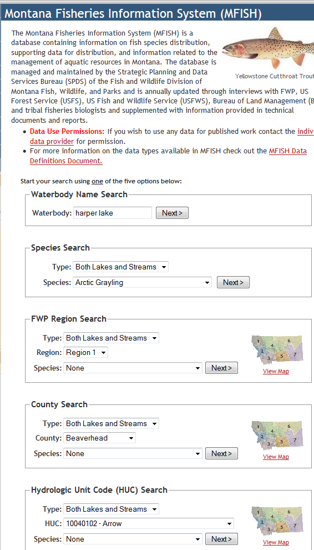
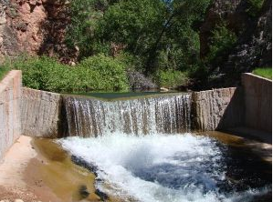
Hydrography Dataset Uses
MFISH database
CAPS
Connectivity, barriers
Property evaluation
Note: Currently using a 100K version of the NHD and taking care of their own edits
Because whole stream identifier required
River miles versus percent of reach distance
Would like to move to 24K NHD

Slide 5
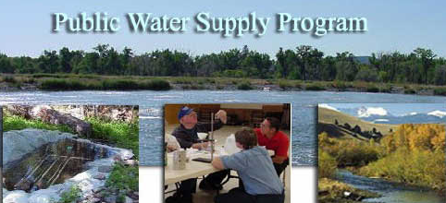
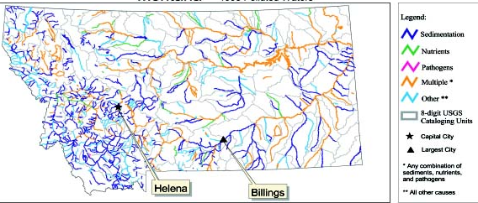
Hydrography Dataset Uses
Clean Water Act Information Center
Assessment units
Federal Superfund
Source water protection
303d listing
Point and line events (discharge points, reference sites, impaired waters)

Slide 6
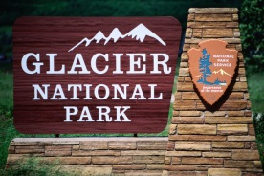
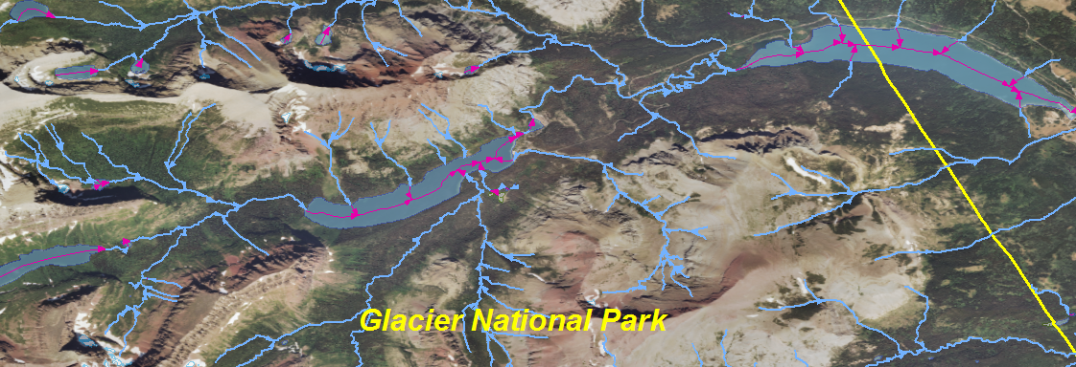
Hydrography Dataset Uses
Substeward with MSL
Actively editing streams, rivers, glaciers, and lakes inside the Park
Most linework has not been updated since the 1960s
In a place as complex and grand as Glacier, accurate maps are crucial and streams are a primary means for navigating

Slide 7
Take Home Messages
The State is making a strong effort to make the Hydrography Dataset the foundation of multiple agencies’ water-related data
Increased water data discovery
Increased data sharing
A common system for linking agency data
Improved spatial analysis and cause-and-effect

