Slide 1

Montana Hydrography Data Stewardship
InterMountain GIS 2014
NHD Workshop
April 7, 2014

Slide 2

Information Services
Services to Libraries
State Publications
Geographic Information
Natural Heritage Program
NRIS
Water Information System

Slide 3
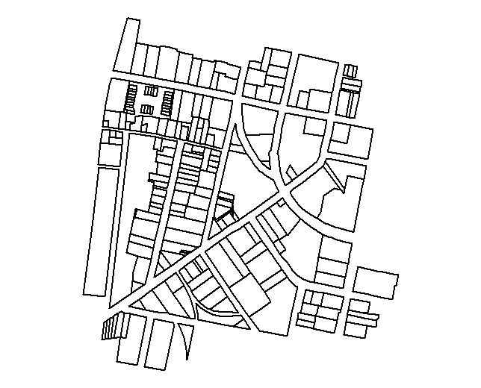
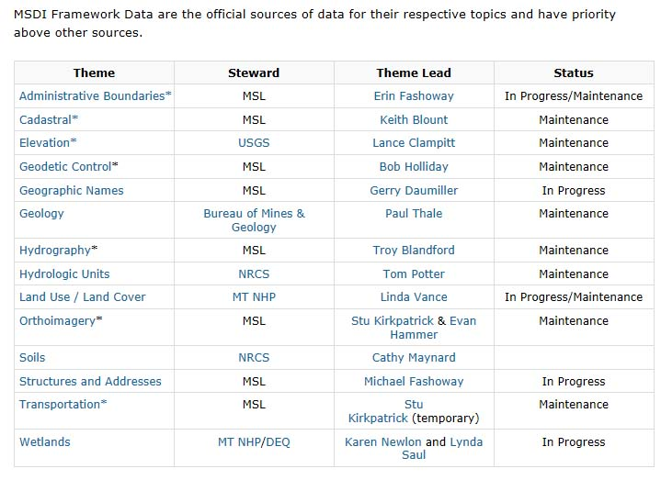
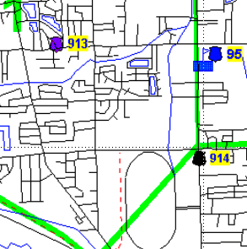
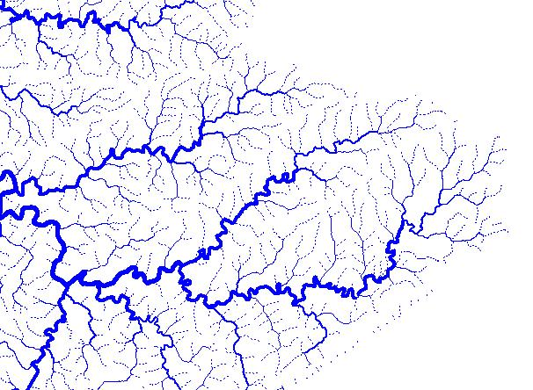
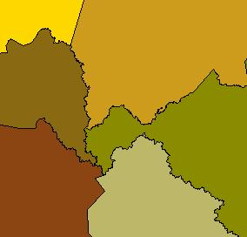
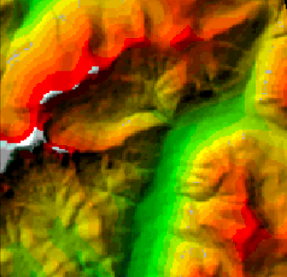
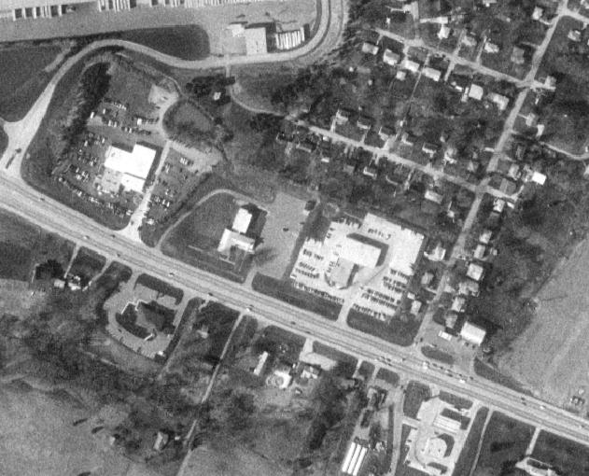
Montana Spatial Data Infrastructure (MSDI)
MT Climate Office Michael Sweet In Progress
Climate MT Climate Office Michael Sweet In Progress
Notes:
-Users have a recurring need for a few common themes of data. These themes provide a framework of reference for most other applications.
-Once these data sets are created to standards and documented, they can be shared across user organizations and used many times to support different decisions. This results in cost savings, organizational efficiencies, and better decision-making.
The Montana Spatial Data Infrastructure consists of digital statewide spatial data themes, vetted through the Montana State Library with the advice of the Montana Land Information Advisory Council (MLIAC), that meet essential spatial information needs of the state of Montana and its citizens. Stewardship is the assumption of responsibility for a MSDI data theme that, depending on the needs of the theme, includes direct or indirect coordination of the production, maintenance, integration, enhancement, distribution, coordination, promotion, and support-resources for that data theme. Effective stewardship of the MSDI will advance framework information as "data you can trust" – the best available data for Montana; standardized, maintained, and discoverable.
The Montana Spatial Data Infrastructure or MSDI contains 15 spatial framework layers. These layers, or themes, are comprised of seven federally defined "geospatial framework data layers" and seven additional themes defined by the State of Montana. These data layers are in various states of development and the completion, dissemination and ongoing maintenance of the MSDI is identified as a top priority by the entire GIS community.
MSDI Framework Data are the official sources of data for their respective topics and have priority above other sources.

Slide 4
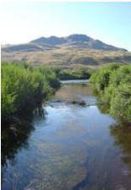

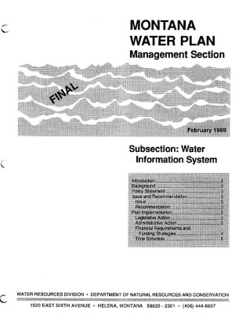
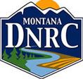

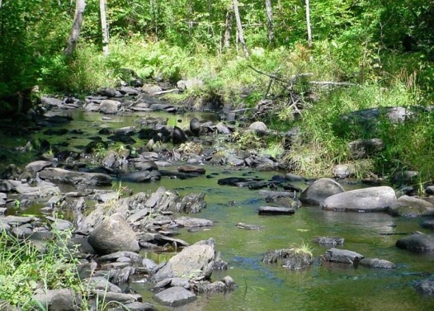

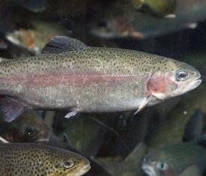
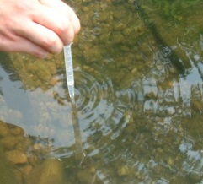
Why a Water Information System?
To facilitate water data discovery and access
To facilitate data sharing opportunities
Notes:
So why is the water information system important or what does it provide? The WIS serves as a discovery hub available to all Montanans, and it increases data sharing opportunities. If you want to find information about Montana’s water resources, the Water Information System is your best start—it is a collection of information from multiple Federal, State and other organizations. It makes data from multiple agencies across the State discoverable from one place. Another way to describe the WIS might be the term aggregator. It aggregates water-related information from multiple agencies, multiple websites into one common discovery place—kindof like Google News. You can discover all the top headlines from multiple newspapers on one page. Then clicking on a link takes you to the source, such as the Washington Post, New York Times, or CNN. The Water information system is a discovery hub for water-related data that directs the user to the top source.
There are potentially many uses of a WIS. Water planning, water quality monitoring/reporting, restoration, permitting, modeling, species distribution, floodplain mapping, fish barriers, dewatering status, instream flow, water rights, dam safety, stream access, land acquisitions (riparian habitat), inventory of small dams/ponds, and more . . .

Slide 5
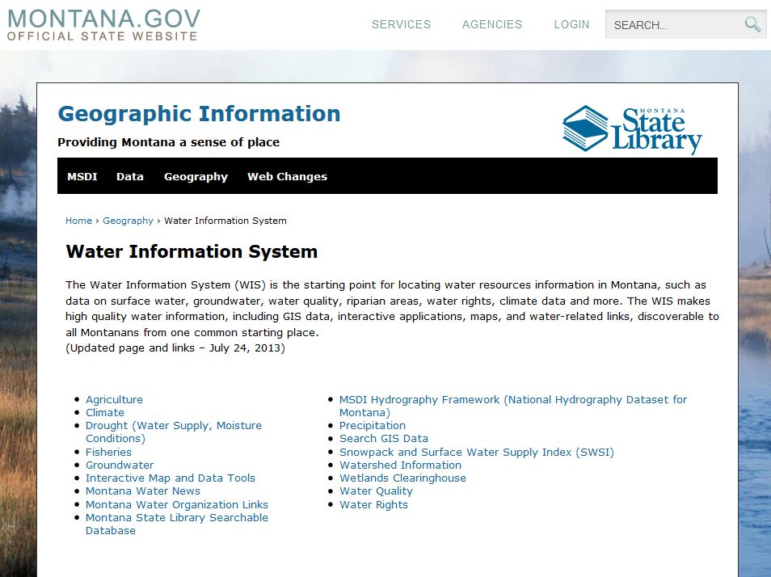
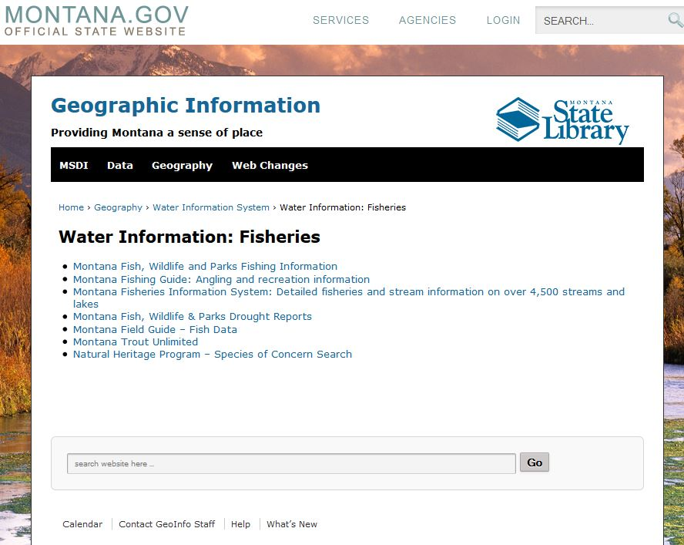
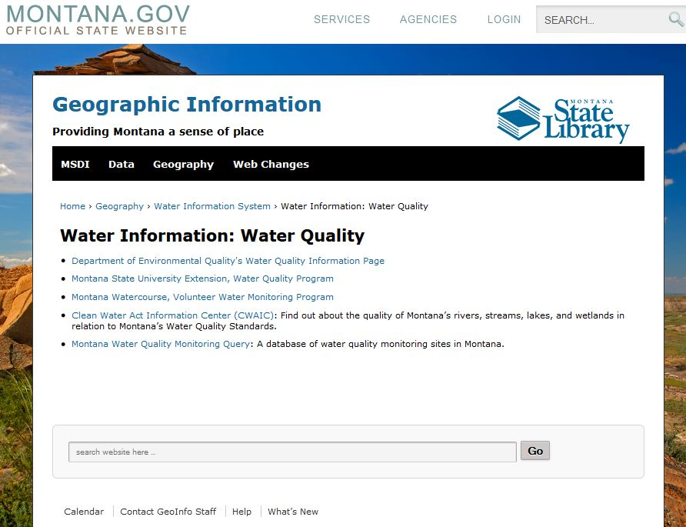
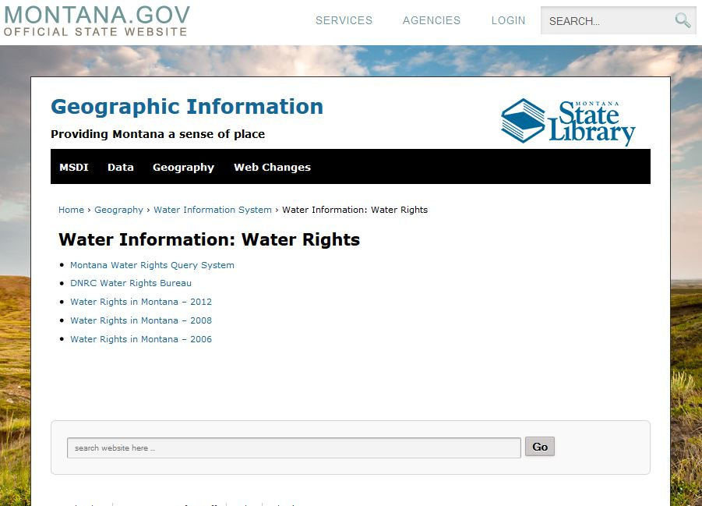
Montana Water Information System
http://geoinfo.montanastatelibrary.org/geography/water/
Notes:
The foundation of the WIS is currently a website with links to various State, Federal, and private entities who provide water data. It is a starting place for discovering water data.
Advantage:
This is a decentralized data system approach enabling agencies to manage their own data for specific business needs, while making the data discoverable to others from one common-starting place (website).
Limitation:
Data come from a variety of places, in a variety of formats, with varying completeness. Data are not readily tied together. That is, there may be no common link or key between the data. For example, go here for this information, here for this information, and over here for this information, then pull it all together and hope that all of the water data work together.

Slide 6
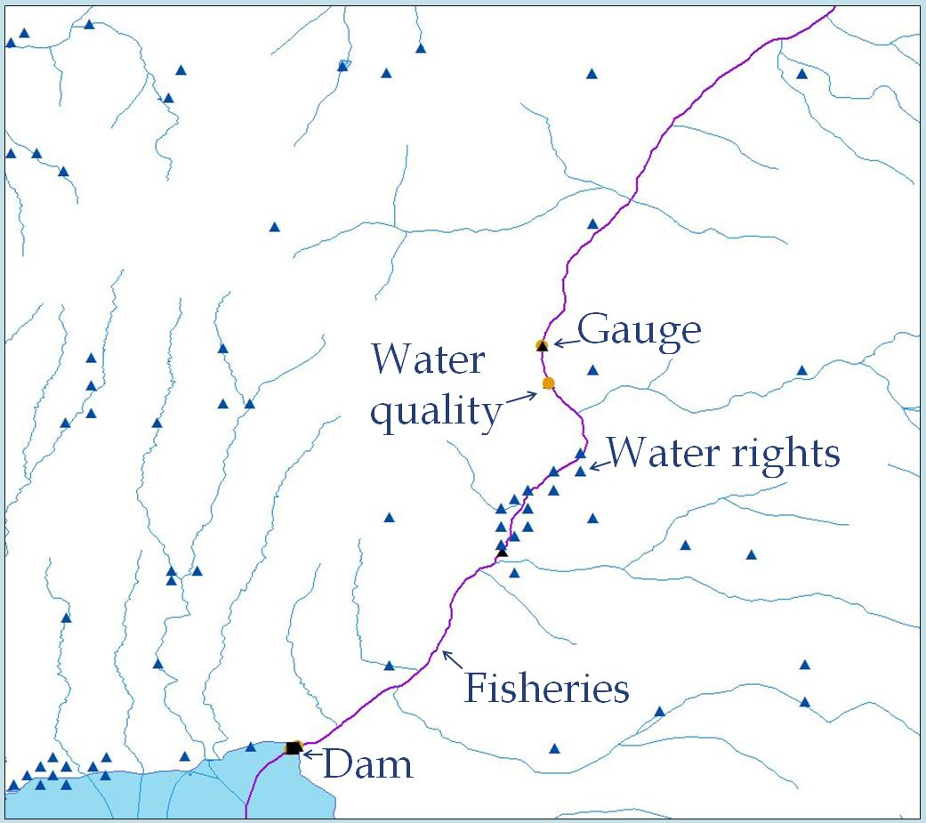
WIS Future
A common spatial hydrography framework (GIS)
Notes:
To compliment the website the State is moving towards restructuring the WIS such that its foundation is a common hydrography framework. The WIS will become more database driven, more spatial, more GIS-based!
There are several advantages:
1. Data become spatially-enabled and upstream, downstream, and other spatial relationships are more easily identified
2. Data are more easily tied together based on their location on the hydrography network.
Once data are tied to/hung-off a common framework, a common stream network, then data discovery, analysis, and modeling all become more straightforward.
Just about all data is spatial. The examples shown on the slide are all physical, measured objects (a dam, fish species, a gauge), but more abstract things such as a “study” or a “literature paper” could be tied to a stream network as well. For example, what if you could find all floodplain studies or papers written about the Madison below Ennis?

Slide 7
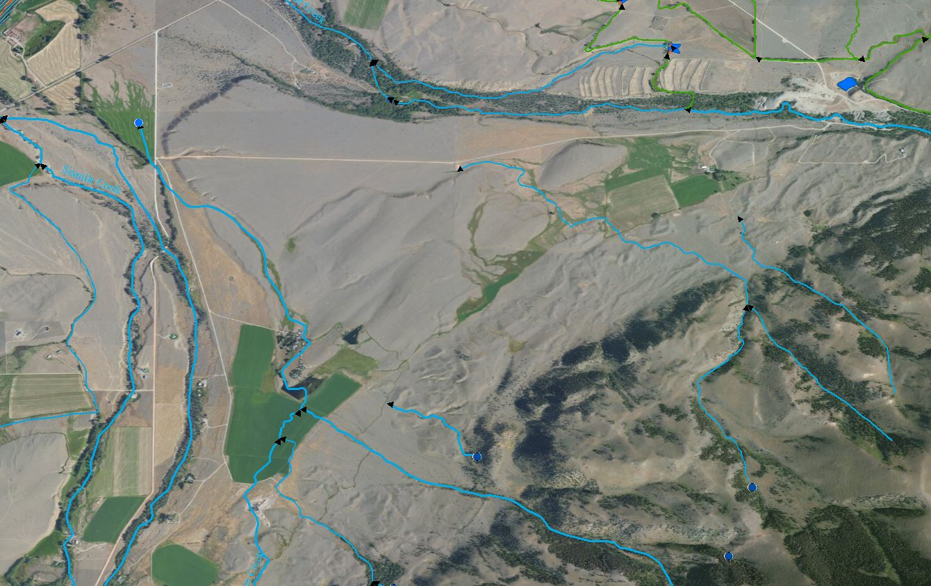
First things first
Missing Names
Disconnected network (missing canals/ditches)
Missing ponds
We need a solid Montana Hydrography Dataset first!
Notes:
I think the biggest reason is it’s a national model—designed to satisfy major uses and needs, but it may not satisfy specific needs. In developing the NHD, USGS grabbed the low hanging fruit. Fine details such as ditches, canals and local names require a more local-level inspection. The USGS recognized this early on in the development of NHD: the program wouldn’t be successful without local-level review and stewardship of the data. It is the States, counties, and watershed groups that work with the detailed data the most and see the hydrographic features on the ground.
So why isn’t it more embedded in business practices? Here are some reasons:
Too much/too complex (working with the NHD is a fulltime position in itself)
Broken features/missing names/it’s not right
It doesn’t match my best source or I’ve got a better source
And the biggest reason, the bottomline, the NHD may not quite meet Montana’s needs or be flexible enough (for example FWP’s need for a whole stream identifier rather than breaking the hydrography into a bunch of reaches and DNRC’s need for local stream and pond names for water rights).
So, first things first. A solid hydrography dataset that has users’ confidence as the best available is critical. The next biennium for the WIS is devoted heavily to improving Montana’s Hydrography Dataset. How do we do this? (next slide).

Slide 8
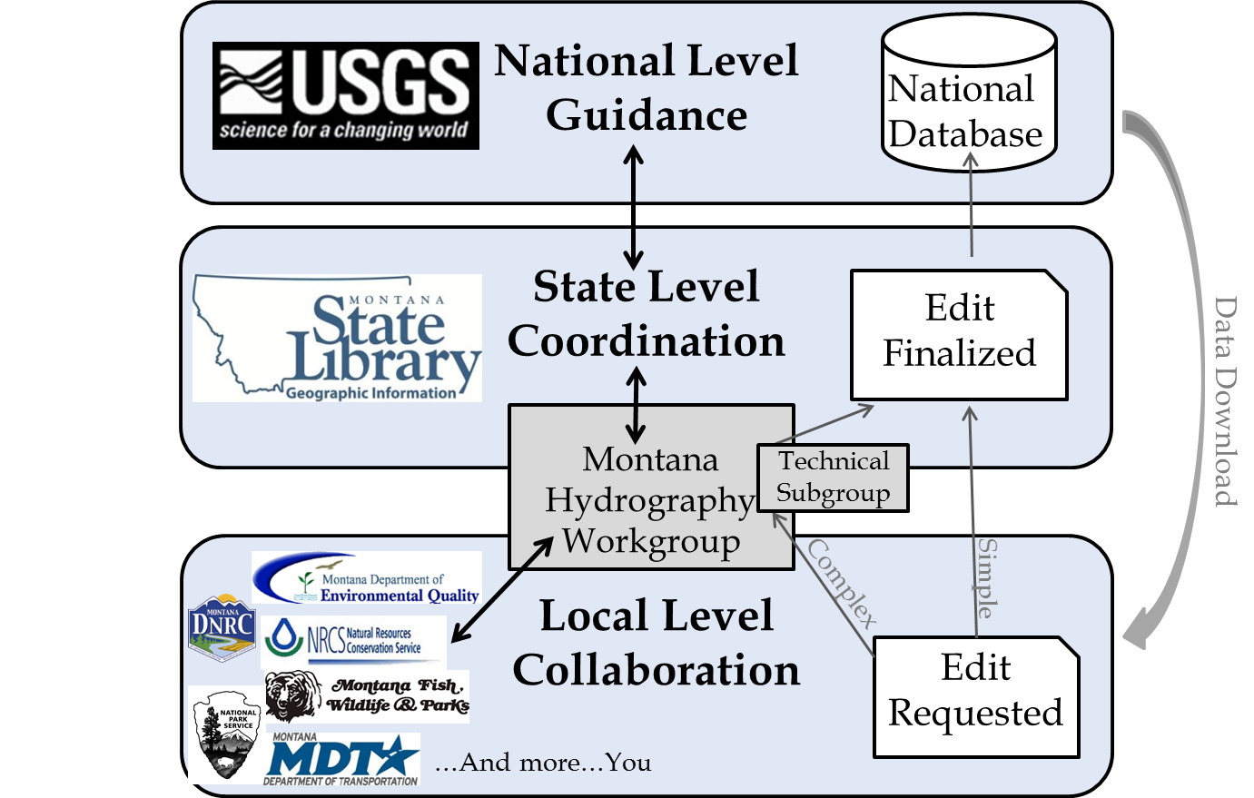
Montana Hydrography Stewardship
Notes:
Montana’s Hydrography Dataset and WIS won’t be successful without stewardship happening at multiple levels: Federal, State, and Local Level.
The left side of this illustration describes who is involved and the right side describes how an edit of the hydrography dataset is carried out.
The USGS provides support and guidance for stewardship and oversees NHD model development and changes to the database schema. The USGS maintains the national database.
The State Library serves as principal steward and coordinates the Montana Hydrography Workgroup—the primary sounding board for hydrography needs and requests. The Workgroup provides direction for the hydrography dataset.
Dataset maintenance needs are identified at the local level, by the entities who use the NHD data regularly. Updates from land owners and local managers are critical for improving the hydrography dataset.
The maintenance process begins with a user downloading the data from the USGS National Database, then recognizing a problem, and submitting an edit request to the State Library. If the edit is simple or straightforward then the Library completes the edit and submits the final revision to the USGS. If the edit is more complex, or it impacts multiple agencies, then the request goes through a review process with the Montana Hydrography Workgroup (or a technical subgroup it). After review, direction for completing the edit is provided to the State Library, and the final revision is submitted to the USGS.

Slide 9
Common types of revisions
• Revisions to spatial location and geometry
• New features
• Name updates
• Correct flow direction
• Feature type revisions (e.g Ftype or Fcode)

Slide 10
Options for submitting edits
Update Option | Intended for: | Targeted NHD/GIS Skill-level | Contributor Effort | Steward Effort | Min Turnaround Time (after contributor submission)
1. Submit form or email | A few to a handful of revisions | Low | 10% | 90% | Days
2. Use the NHD Update Tool | Mass revisions (impending) | High | 70% | 30% | Weeks
3. Send own data | Multiple revisions (preexisting or resulting from other business needs) | Medium | 30% | 70% | Months

Slide 11
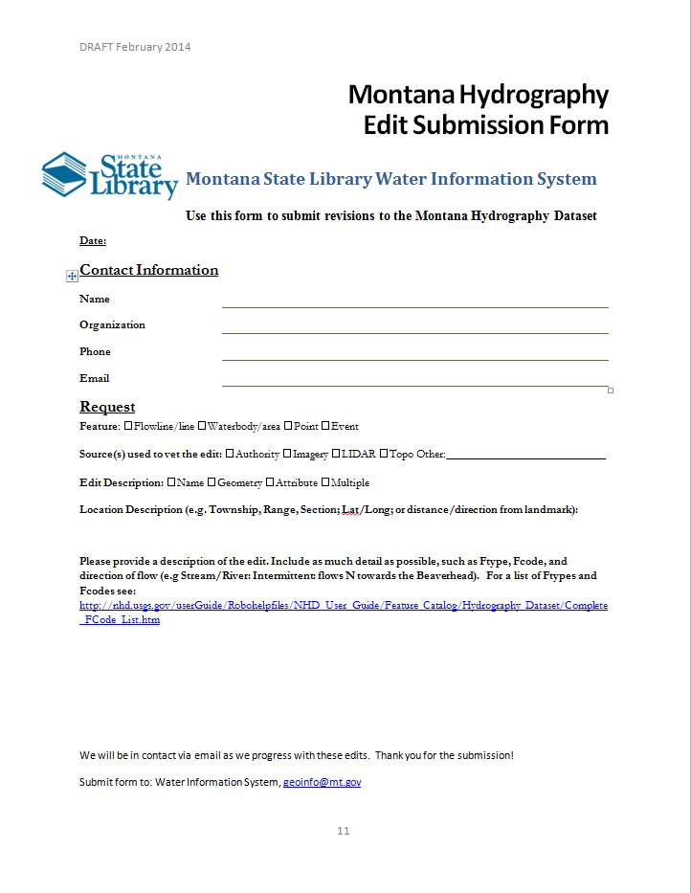
Edit Submission Form

Slide 12
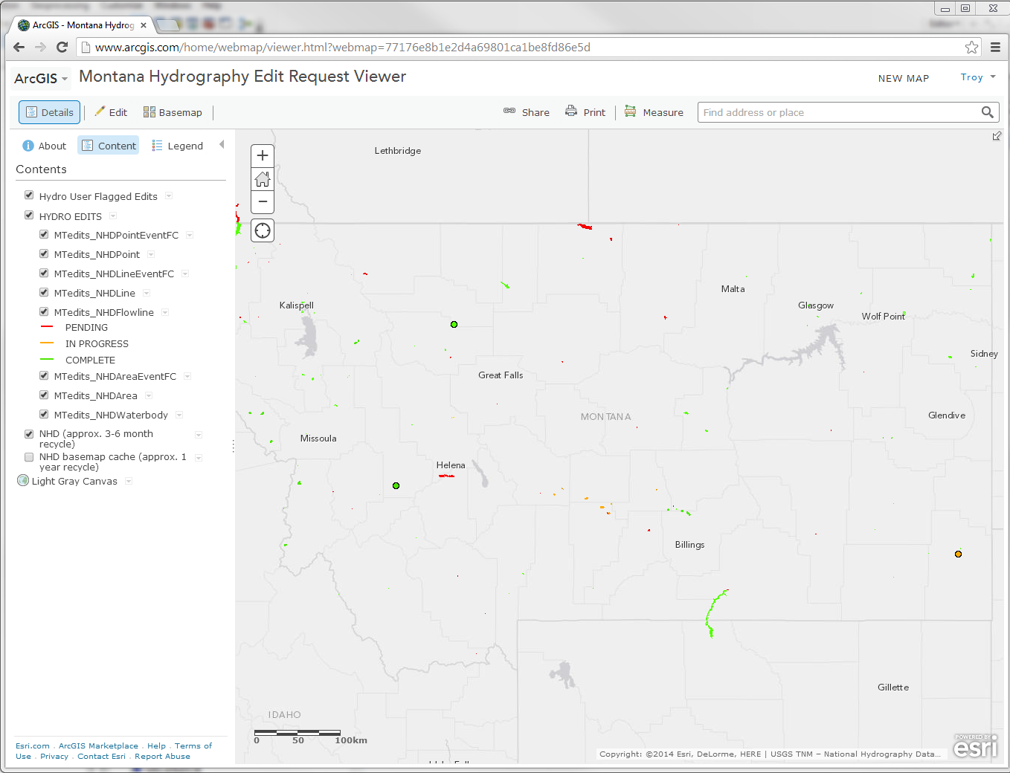
Track the status of your submission

Slide 13
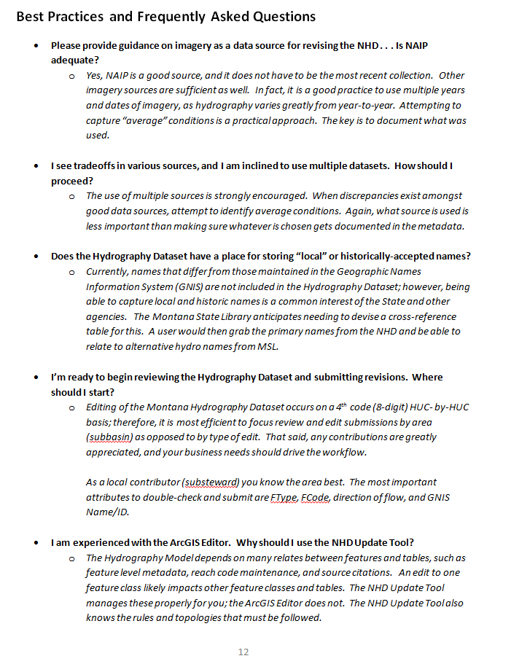
Best Practices and FAQ

Slide 14





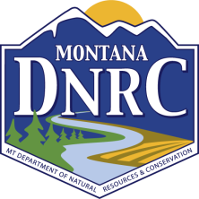



Get Involved
Join the Montana Hydrography Workgroup (Google, “MAGIP Hydrography Workgroup”)
NHD Stewardship and Maintenance
  Contact: geoinfo@mt.gov
Who can contribute? Anyone…you
Notes:
If you have hydrography data needs, ideas to improve the State’s hydrography data, or data you’d like to share, please join the Montana Hydrography Workgroup. You can find us through Google Groups (search for “MAGIP Hydrography Workgroup”). You’ll receive emails with updates, notifications for workgroup meetings, and other important information.
The State Library is your Hydrography Dataset Steward. Submit NHD questions, maintenance requests, and edits to the Library.
Soon we will be developing a more formal workflow for submitting edit requests. In the meantime, email questions to geoinfo@mt.gov.

Slide 15
Take Home Messages
If you’re looking for water data, think the Montana Water Information System
Montana Hydrography Dataset requests, questions, and edits should be directed to the Montana State Library (geoinfo@mt.gov)
“On-the-ground” knowledge and contribution is critical to the improvement of the Montana Hydrography Dataset.
Stay Tuned!
Notes:
If you’re looking for water data, think the Montana Water Information System. It’s a good place to start your search.
The NHD is a powerful addressing system for water-related data. Using it improves data discovery and sharing.
I strongly recommend using the NHD as the foundation for water projects. Think about this when you write grants or RFPs…request that data be referenced to the NHD whenever possible.
NHD questions, data requests, and edits should be directed to the State Library (geoinfo@mt.gov)

