Slide 1
Sources of NHD Data
InterMountain GIS 2014
NHD Workshop
April 7, 2014

Slide 2
Where is the best place to get NHD data?
What do you need the data for?
How recent do you need the data to be?
Notes:
It depends on what you need the data for and how recent you need the data to be. There are two primary resources of NHD data for Montana: the Montana State Library and the USGS. Let’s look at what you can find from the Montana State Library first.

Slide 3
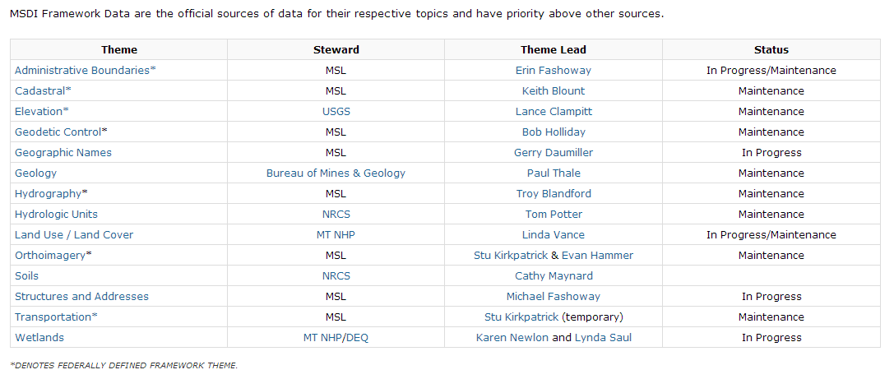
Montana Spatial Data Infrastructure (MSDI)
http://geoinfo.montanastatelibrary.org/data/msdi/
Climate Montana Climate Office Michael Sweet In progress
Notes:
Hydrography is one of the MSDI themes, which is also a federally defined framework theme.

Slide 4
Hydrography
Notes:
From the MSDI Hydrography page, you can access NHD data for Montana, documentation about the NHD database schema, and also the National Map NHD Viewer, built and maintained by the USGS.

Slide 5
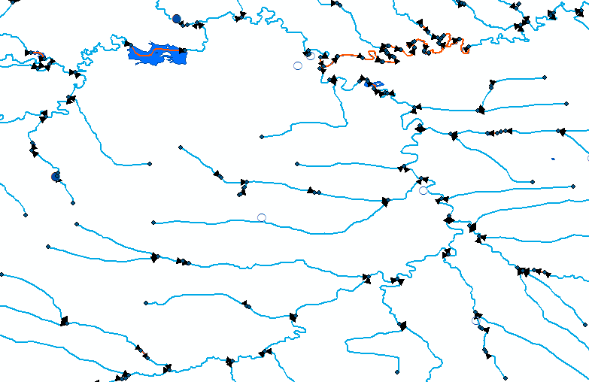
NHD High Resolution (1:24K) Data
Available in Montana State Plane Coordinate System (NAD_1983_StatePlane_Montana_FIPS_2500_meters).
http://geoinfo.montanastatelibrary.org/geography/water/nhd/nhd_download/
Notes:
The data available from the MT State Library is not the most recent NHD data. It is updated approximately every two months. The advantage of obtaining your data from here is that it is already in the Montana State Plane projection.

Slide 6
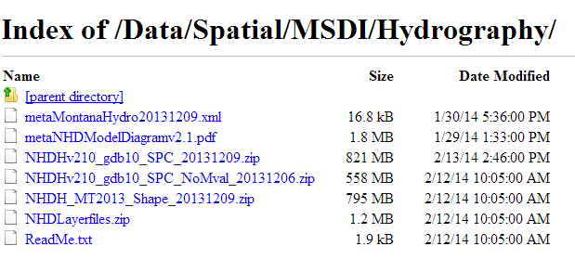
FTP site
ftp://ftp.geoinfo.msl.mt.gov/Data/Spatial/MSDI/Hydrography/
Notes:
Because you download the data directly from an FTP site, it is also easy to obtain statewide data without going through a lot of steps. You can also download a zipfile containing layers which will help you symbolize the various FCodes associated with each feature class.

Slide 7
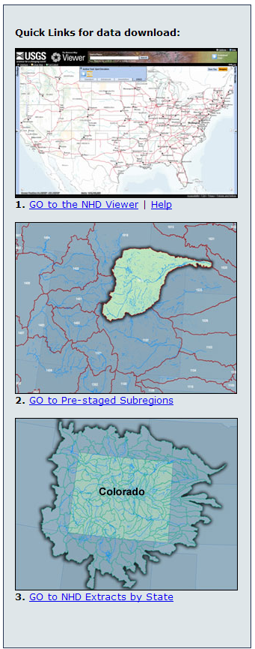
USGS Hydrography
Multiple ways to download and view NHD data from the USGS
NHD Viewer
NHD extracts by state
Pre-staged subregions
Map services
http://nhd.usgs.gov/index.html

Slide 8
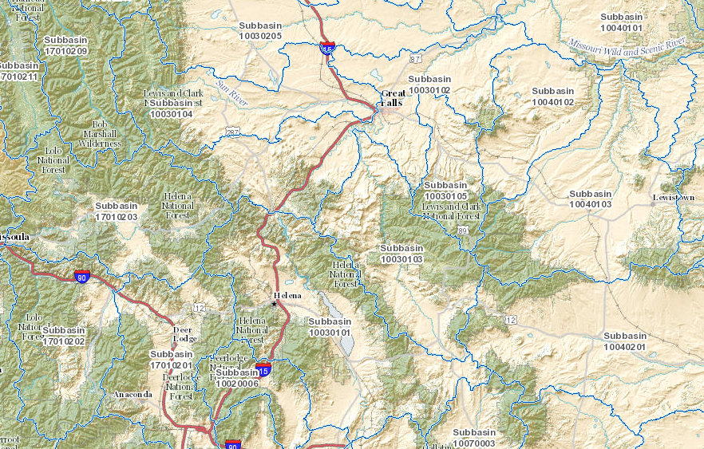
The National Map Viewer
Notes:
The best way to obtain the most up-to-date NHD data is to use the NHD, or National Map, Viewer. It is an interactive application allowing you to download data at various scales and in various formats.

Slide 9
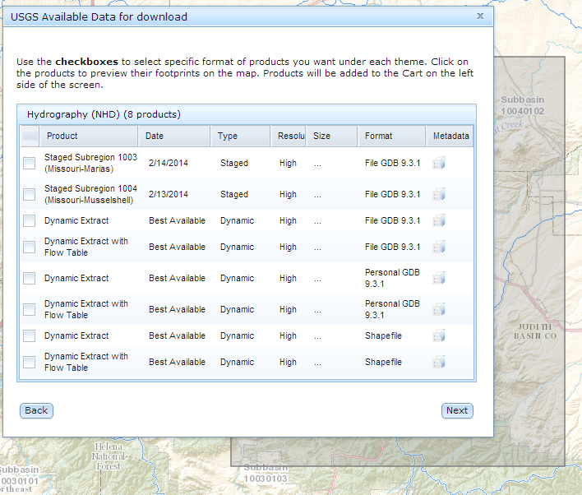
Product Availability
http://viewer.nationalmap.gov/viewer/
Notes:
Dynamic Extracts represent the most recent data available and are updated within a week of edits being submitted. Using the download data function of The National Map Viewer is the best method to obtain the most recent data. The only downside may be that it is not as easy as other methods to obtain a large dataset covering a large extent.

Slide 10
NHD Extracts by State
High resolution = 1:24K
Medium resolution = 1:100K
Local resolution = 1:5K or greater
ftp://nhdftp.usgs.gov/DataSets/Staged/States/
Notes:
You can choose to download statewide NHD datasets according to high, medium, or local resolution. Montana’s NHD is currently only available in high resolution. The medium resolution NHD is the dataset compatible with NHDPlus, which has additional analytical functions associated with it.

Slide 11
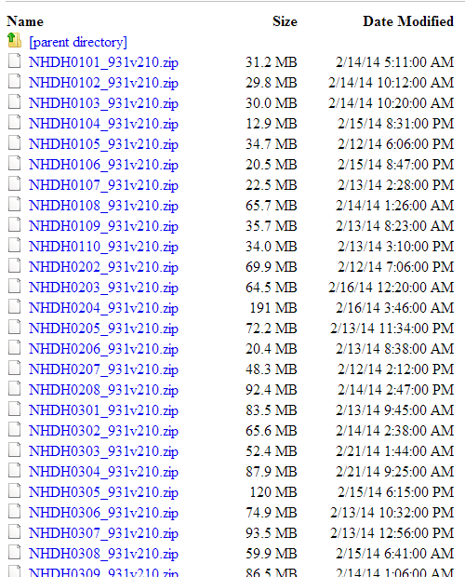
Pre-staged Subregions
Subregions are also available in multiple resolutions
Know the 4-digit HUC code beforehand
Data updated within ~2 weeks of edits being submitted
ftp://nhdftp.usgs.gov/DataSets/Staged/SubRegions/

Slide 12
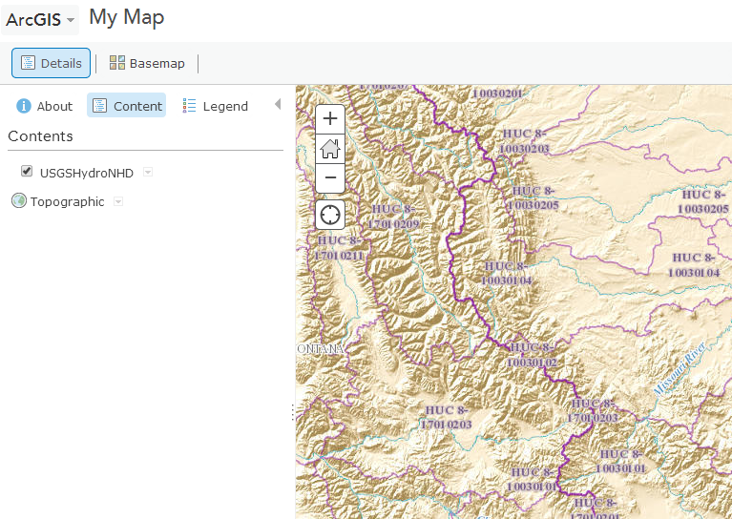
USGS Rest MapService Endpoint
NHD as a map service
Can view in:
ArcGIS.com Map
Google Earth
ArcGIS Desktop
http://basemap.nationalmap.gov/arcgis/rest/services/USGSHydroNHD/MapServer
Notes:
If you don’t need to manipulate NHD data but need to be able to view it, the USGS Rest MapService Endpoint is a useful tool. You can also add this as a service in your ArcMap session using the Add a GIS Server function.

Slide 13
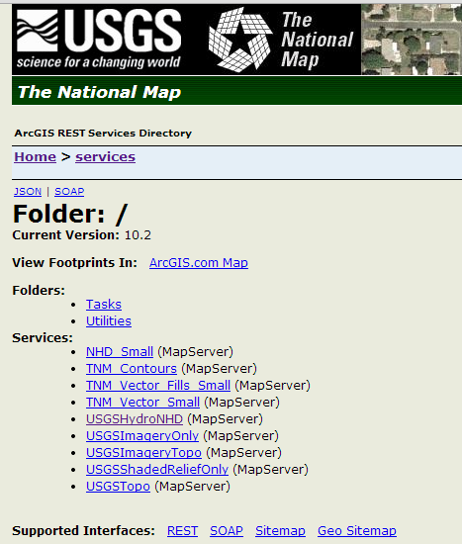
Other Services
http://basemap.nationalmap.gov/arcgis/rest/services
Notes:
You can also access other map services from the USGS, such as USGSTopo, which can provide good ancillary information for your projects.

Slide 14
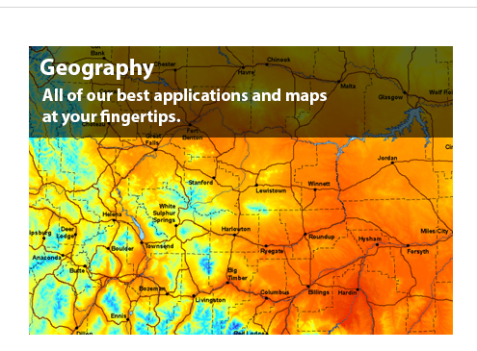
NHD Resources
Notes:
To reiterate, depending on your needs, either the USGS or the Montana State Library are the best sources of NHD data and provide a variety of formats for the user.

